Slide 1
Clean Intermittent Catheterization (CIC)
Ann Roper, MSN, RN, CURN
Pediatric Urology
Children’s Hospital of Richmond
Virginia Commonwealth University
Richmond, Virginia
Kennary choung, bsn, rn, cpn
Pediatric urology
Boston children’s hospital
Boston, ma

Slide 2
Financial Disclosure statement?

Slide 3
Clean Intermittent Catheterization
Purpose
History
Types of catheters
Nurse’s visit: Guide and Technique
Estimated Bladder Capacity
Challenges
Tools For Teaching
Top Tips
Identifying Barriers and Nursing Advocacy
https://www.bnd.com/living/magazine/article225938210.html

Slide 4
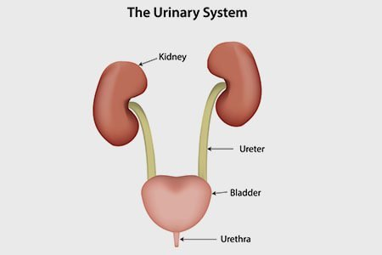
Catheterization
Catheterization is a treatment modality used by patients diagnosed with a neurogenic, anatomical, or functional disorder of the bladder .Its purpose is to preserve renal/bladder function and/or achieve continence (Lapides et al, 1972).
Example Diagnoses:
Posterior Urethral Valves
Spina Bifida
Cerebral Palsy
Hinman Syndrome (non neurogenic neurogenic bladder)
Traumatic spinal cord injuries
Urinary Incontinence/ Incomplete bladder emptying

Slide 5
Urinary Catheters
Brief Historical Timeline
3000 BC
Early to Middle Bronze Age
●Ancient Syrians were documented to have first used catheters
1500 BC
1100s
1752
1836
Romans, Hindus, Greeks and Chinese were documented to use various types of materials for catheter such as:
Ancient Egyptian papyrus recorded treatment of urinary retention with:
Benjamin Franklin became earliest American inventor to create silver flexible catheters for his brother suffering from kidney stones
Louis Auguste Mercier invented the coudé (elbow) catheter
●The term “catheter” was derived from the Greek connotation “to let down into” (brief his)
1900s
●1929: Dr. Frederic E.B. Foley created a latex foley catheter
●1940s:David S Sheridan created modern disposable catheters
●1945: Sir Ludwig Guttman introduced the concept of sterile intermittent catheterization in patients with spinal cord injury
●1971: Dr. Jack Lapides introduced the clean intermittent catheterization technique.
Tubes of wood
Precious metals
Onion stalks
Rolled up leaves and straws
Reeds
Transurethral bronze tubes
Reeds
Straws
Curled-up palm leaves

Slide 6
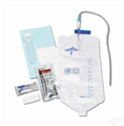
Types of Catheters
Typical catheter sizes range from 5Fr to 24Fr
Straight Tips are most common
Coudé Tips: Slight curve that may assist with passage through a urethral strictures, blockages, enlarged prostates, or false passages.
Olive Tips: Ball-shaped tip with slight curve to provide a smoother passage for patients with urethral obstructions, enlarged prostate, blockages, false passages, or atrophic vagina
Hydrophillic: Water soluble, pre-lubricated catheters
Catheter Kits: – includes catheters, lubricant, gloves, towellette, underpads, A4352
Closed System : Catheters with a measuring bag attached (?discuss they are popular with pts who are wheel chair bound)
Sterile all inclusive closed system – A4353
Single sterile package – A4351 ( can be one needing lubrication or hydrophilic)

Slide 7
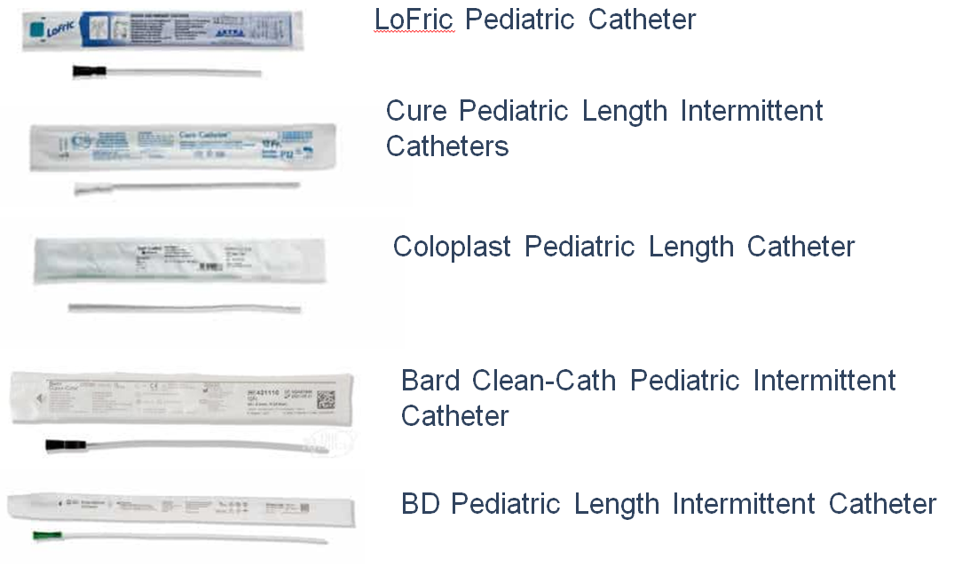
Types of Catheters (cont.)

Slide 8
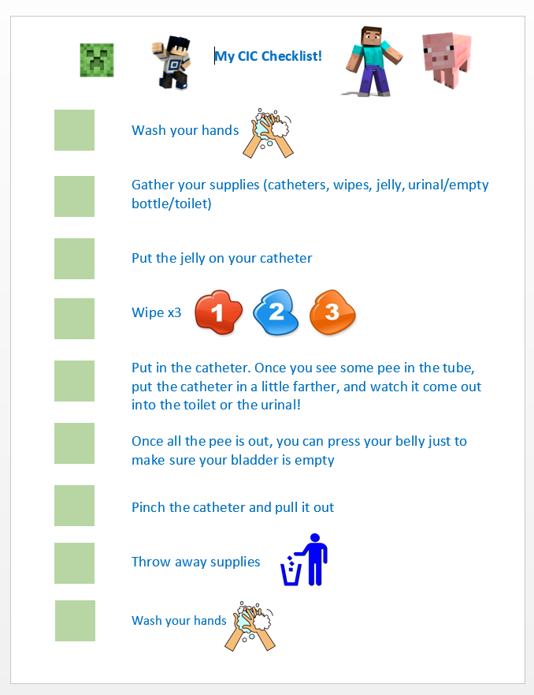
Nurse Visit Teaching Session
Introduction
Play an educational video on CIC
Review the importance and need for CIC
Answer questions and address concerns
Have the patient touch and feel the catheter. Make it fun by using a model/doll
Review anatomy, proper CIC technique/ checklist
Have patient and/or primary caregiver attempt to CIC
Bladder Scan for PVR
Offer additional sessions

Slide 9
Are Kids Ready To Cath?
Individualized depending on maturity and hand dexterity of child.
Can begin with supervision. Child will be able to insert catheter but often take it out before bladder is empty. No definitive age but typically early elementary (6-8 years old) will have maturity to catheterize with adult supervision.
Watches are helpful for reminders.
https://www.dreamstime.com/disabled-child-handicapped-children-wheelchair-disabled-child-handicapped-children-wheelchair-boy-broken-leg-image171584347

Slide 10
Estimated Bladder Capacity
(Age+2) X 30
Example:
4 year old
(4+2) x 30= 180ml estimated bladder capacity
https://cdn.ps.emap.com/wp-content/uploads/sites/3/2018/09/Table-2.-Terminology-and-normative-measurements_660.jpg

Slide 11
Challenges
Wheelchair or mobility issues
Hand dexterity – spinal cord injuries (opening packaging)
Body habitus – positioning, mirrors
https://www.vectorstock.com/royalty-free-vector/a-child-wheelchair-vector-29613468

Slide 12
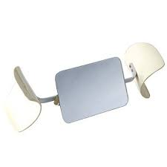
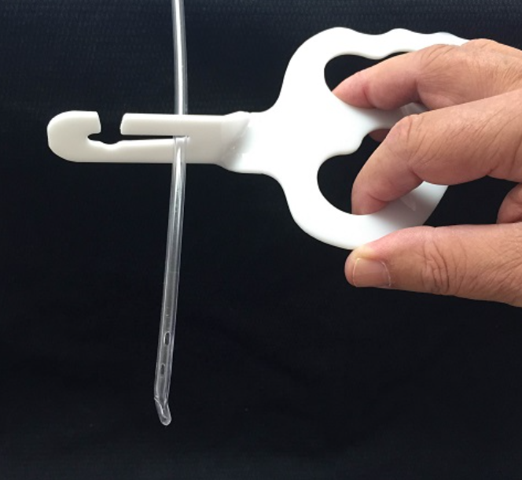
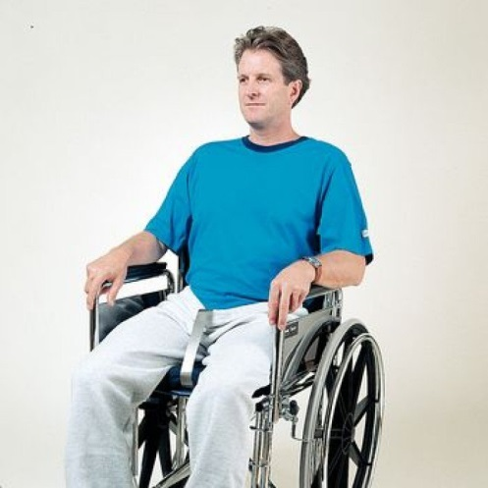
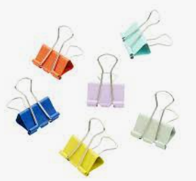
Use Mirrors, Lighting, Adaptive Devices
Knee spreader with mirror
My way insertion aid
Betty Hook
http://t2.gstatic.com/images?q=tbn:ANd9GcSh8GCnxjeFnjOJGV4fSy4PT8G0MV13Ay6g3458pH4TTk4EymP0
MiWay™ Intermittent Self Catheterization Gripping Aid
https://w800x800/9df78eab33525d08d6e5fb8d27136e95/2/0/2031.jpgww.4mdmedical.com/media/catalog/product/cache/1/image/
https://commedpro.com/wp-content/uploads/2015/06/IMG_1154web.jpg
Binder Clips
https://faerieflysavingsmomma.blogspot.com/2012/03/5-ways-2-play-with-flashlight.html

Slide 13
https://steelbone.co.uk/wendys-top-tips-on-benefit-applications/

Slide 14
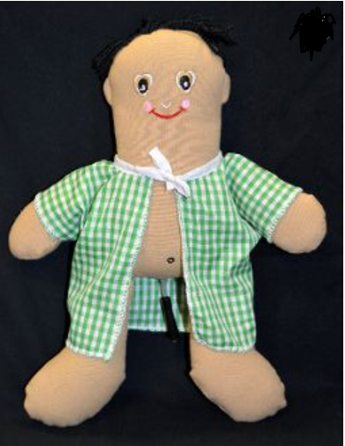
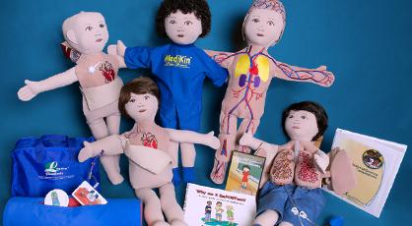
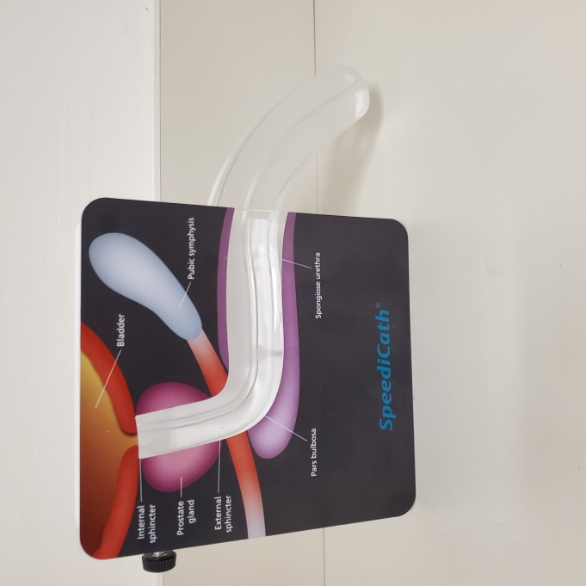
Provide Access to Educational Materials
Shadow Buddies Doll
https://shadowbuddies.org/product/self-cath-buddy/
https://legacyproductsinc.com/medikins
Kids' Guide: Using a Catheter
by Pediatric Urology Nurse Specialists
Beads to increase fine motor skills
180Medical CIC Book
Coloplast, male model

Slide 15
Provide Private Environment for CIC
https://www.picserver.org/highway-signs2/images/privacy.jpg
https://www.picserver.org/highway-signs2/images/privacy.jpg

Slide 16
Allow Enough Time for CIC Teaching
https://pngimg.com/uploads/clock/clock_PNG6642.png
This Photo by Unknown Author is licensed under CC BY-NC

Slide 17
Importance of CIC
https://www.allaboutlean.com/wp-content/uploads/2018/07/5-Why-Graphic.png

Slide 18
Positioning Tips
https://pngimg.com/uploads/wheelchair/wheelchair_PNG17848.png

Slide 19
When To Check Urine
https://www.nps.org.au/assets/70b382fb46e1397e-7bf53a050ea0-Nitrofurantoin-fosfomycin-UTIs-GettyImages-474012076.jpg
https://www.flickr.com/photos/wwworks/14648490416

Slide 20
Discuss Preparations for School and Travel
https://en.wikipedia.org/wiki/School_bus
https://freepngimg.com/png/26480-airplane-clipart

Slide 21
Possible Barriers to Compliance
Social/emotional anxiety or fear of CIC outside the home
Lack of understanding of the importance of CIC
Insurance coverage/ access to supplies
Insufficient bathrooms and cleanliness (private and/or public)
Male bathroom often do not have private stalls or private receptacle to dispose of supplies
Lack of nursing staff, knowledge and resources in schools
Insufficient time for CIC during transit periods at school or work
Patients’ or parents’ school/work schedule
Lack of support or other caregivers assisting with CIC for a younger child

Slide 22
Urology Nursing Advocacy
Urology nurses are strong advocates that can assist with addressing certain barriers a child may have to success and compliance with CIC
Nursing can identify and include additional support systems for patient and families that may include but not limited to PCPs, school RNs, LICSW, CLS and psychologist
An interdisciplinary approach can help create awareness, identify challenges and implement new strategies for successful CIC
Some suggestions to increase compliance:
Creating mentorship opportunities between experienced patients and new patients
Refer pts to online resources such as “Experience Journal” or social media support groups
Telemedicine for additional teaching sessions

Slide 23
References
Newman, D.K. (2021). Intermittent Self-Catheterization Patient Education Checklist. Urologic Nursing, 41(2), 97-109. https://doi.org/10.7257/1053-816X.2021.41.2.97.
Newman, D.K. (2021). Methods and types of urinary catheters used for indwelling or intermittent catheterization. Urologic Nursing, 41(2), 111-117, https://doi.org/10.7257/1053-816X.2021.41.2.111
Welch, VW., Thompson, D.L. & Quallich, S.A. (2021). Executive summary: Current evidence related to intermittent catheterization: a SCOPING REVIEW. Urologic Nursing 41(2), 63-64, 69. https://doi.org/10.7257/1053-816X.2021.41.2.63
http://www.urotoday.com/urinary-catheters-home/history-of-urinary-catheters.html
﻿
http://www.urotoday.com/urinary-catheters-home/history-of-urinary-
https://www.180medical.com/product-details/catheter/bd-coude-catheter/
https://cdn.ps.emap.com/wp-content/uploads/sites/3/2018/09/Table-2.-Terminology-and-normative-measurements_660.jpg
https://shadowbuddies.org/product/self-cath-buddy/

